Slide 1
CSCI-1620
Swing I

Slide 2
GUI
Coding in a command line environment like Unix is perfect for learning the basics of programming and algorithms
However more commercial and intuitive programs provide a visual interface
GUI
Graphical User Interface

Slide 3
Swing
Java has a package, javax.swing, that contains much of what is needed to (relatively) easily create GUI components
Dialog Boxes
Text Boxes
Buttons
Drop Down Menus
…much, much more!

Slide 4
Swing
Your unix account is not capable of displaying graphics, so you will not be able to implement these concepts there
Rather use the IDE of your choice (such as Eclipse as discussed previously)

Slide 5
JOptionPane
The JOptionPane can be used to create quick dialog boxes for simple input and output
JOptionPane has static methods for one-time use input and output

Slide 6
JOptionPane
static String showInputDialog(Object)
When called upon will display an input dialog box with a message that is the passed Object’s toString()
Typically a String is passed
The dialog box has two buttons
OK – Returns whatever String has been entered and closes the dialog box
Cancel – Returns null and closes the dialog box

Slide 7
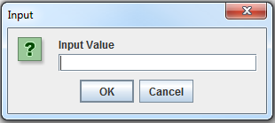
JOptionPane
For example executing:
String input = JOptionPane.showInputDialog(“Input Value”);
Will display the following:
The user can then enter characters into the field and hit OK or Cancel
If OK is pressed the entered String will be returned

Slide 8
JOptionPane
static void showMessageDialog(Component, Object, String, int)
When called upon will display a dialog box with a message that is the passed Object’s toString()
Typically a String is passed
The title of the box will be the String that is passed
The int will be satisfied by one of 5 static data members and determines the icon displayed in the dialog box (if any)

Slide 9
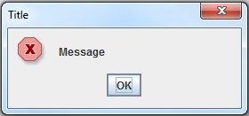
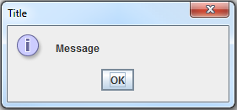
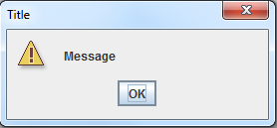
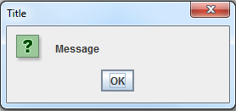
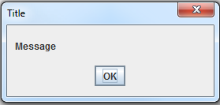
JOptionPane Message Types
ERROR_MESSAGE
INFORMATION_MESSAGE
WARNING_MESSAGE
QUESTION_MESSAGE
PLAIN_MESSAGE
No Icon

Slide 10
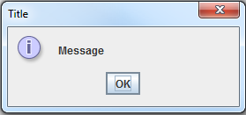
JOptionPane
For example executing:
JOptionPane.showMessageDialog(null, “Message”, “Title”, JOptionPane.INFORMATION_MESSAGE);
Will display the following:
The user can hit OK or close the window to dismiss the message

Slide 11
JOptionPane
The Component argument can be used to place the JOptionPane into a larger window
If null is passed it will default to its own small window as shown in the previous example
Both of these methods are overloaded to accept different options such as:
Displaying Custom Icons
Predetermined Selections
Default Input

Slide 12
import javax.swing.JOptionPane;
public class Addition
{
public static void main(String args[])
{
String firstNumber = JOptionPane.showInputDialog("Input Value");
String secondNumber = JOptionPane.showInputDialog("Enter second integer");
int number1 = Integer.parseInt(firstNumber);
int number2 = Integer.parseInt(secondNumber);
int sum = number1 + number2;
JOptionPane.showMessageDialog(null, "The sum is " + sum, "Sum of Two Integers", JOptionPane.PLAIN_MESSAGE);
}
}

Slide 13
Some Basic Components
JLabel
Displays uneditable text or icons
JTextField
Editable text box to receive user input
JButton
Can trigger an event when pressed
JCheckBox
Can be selected or unselected
JComboBox
Drop down list of items to be selected
JList
List of items, multiple can be selected
JPanel
Area for components to be organized

Slide 14
JFrame
The previously listed components can be used to make a useful GUI application, but they need to be housed by some window or container
JFrame can be used to create a window and gives a place for these components
JFrame can be inherited by your own frame class and customized
JFrame has everything you need to build a windowed GUI

Slide 15
Some JFrame Methods
void setLayout(LayoutManager)
Determines how added Components will be layed out
Component add(Component)
Adds a Compenent to the frame, same Component is returned
void setSize(int, int)
Set the size of the window to passed width and height
void setVisible(boolean)
JFrames typically start out invisible
void setDefaultCloseOperation(int)
What happens when the window is closed
JFrame.DO_NOTHING_ON_CLOSE
JFrame.HIDE_ON_CLOSE
JFrame.DISPOSE_ON_CLOSE
JFrame.EXIT_ON_CLOSE

Slide 16
import java.awt.FlowLayout;
import javax.swing.*;
public class MyJFrame extends JFrame
{
private JLabel label;
private JTextField textField;
private JButton button;
private JCheckBox checkBox;
private JComboBox<String> comboBox;
private JList<String> list;
private JPanel panel;
public MyJFrame()
{
//Call JFrame's constructor, passed String will be window title
super("JFrame Test Window");
//Set the Frame's Layout
setLayout(new FlowLayout());
//Create some components
label = new JLabel("I'm a JLabel");
textField = new JTextField("Type here");
button = new JButton("Press me");
checkBox = new JCheckBox("Toggle me");
String[] choices = {"Choice 1", "Choice 2", "Choice 3"};
comboBox = new JComboBox<String>(choices);
list = new JList<String>(choices);
panel = new JPanel();
add(label); add(textField); add(button); //Add components to the Frame
panel.add(checkBox); //Add components to the Panel
panel.add(comboBox);
panel.add(list);
add(panel); //Add the Panel to the Frame
}
}

Slide 17
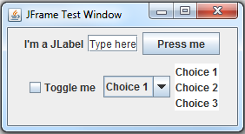
import javax.swing.JFrame;
public class Driver
{
public static void main(String args[])
{
MyJFrame myFrame = new MyJFrame();
myFrame.setDefaultCloseOperation(JFrame.EXIT_ON_CLOSE);
myFrame.setSize(280, 150);
myFrame.setVisible(true);
}
}

Slide 18
FlowLayout
The FlowLayout will add items from left to right until there is not space, then will add items below from left to right
Resizing the window will “Reflow” the components to take up as little space as possible
Other layouts will position items differently and can be viewed here:
http://docs.oracle.com/javase/tutorial/uiswing/layout/visual.html

Slide 19
JPanel
JPanel can be used for better organization
It is a component that is also a container
Notice in the previous example that when resizing the window causing reflow the last three items are never separated, this is because within the Frame the Panel is a single component even though the Panel itself holds three items

Slide 20
Up Next: Events
At this point all of our components are only visual, they don’t actually do anything when the user interacts with them
Next we will talk about Events and Event Handling in order to make use of our GUI

